Slide 1
Predicting and Improving "Life After Strathmore"
Predictive Modeling and Qualitative Feedback Analysis on Graduate Outcomes

Slide 2
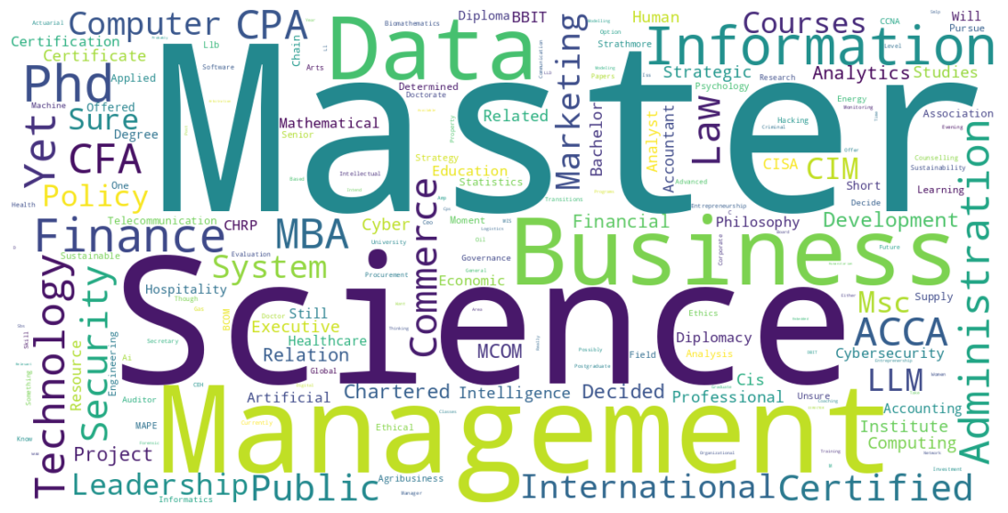
Group 5 Members
Farzeen Wilson
Hellen Omiti
Keenan Kibaliach
Lewis Gichuki
Lawrence Kilinga

Slide 3
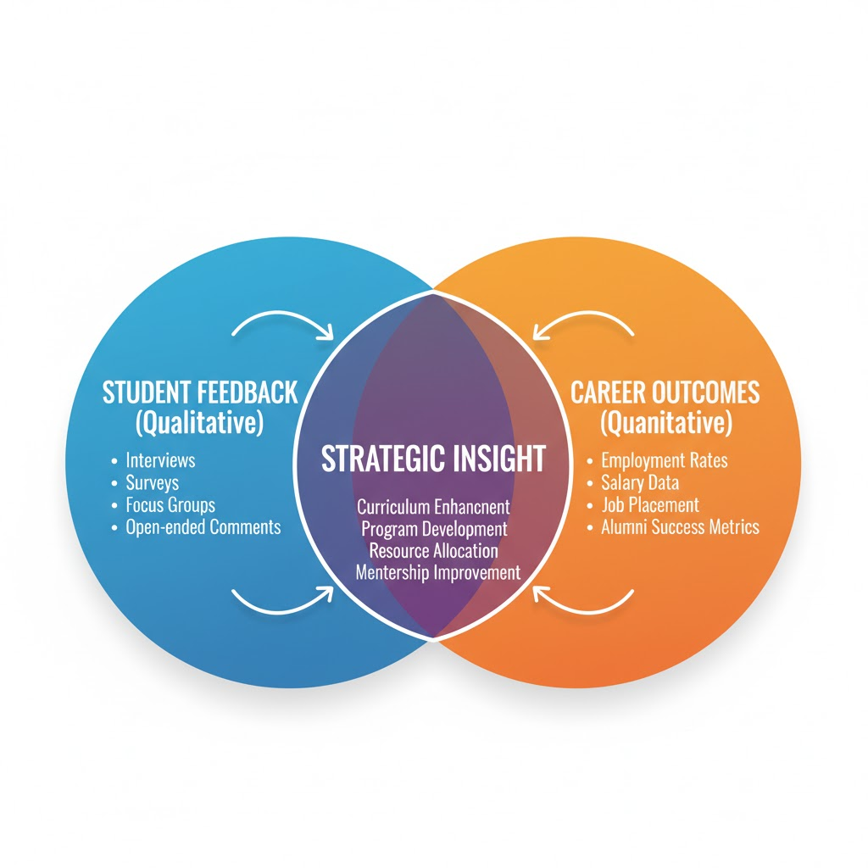
The Problem and Our Goal
The university needs a cohesive, data-driven system to both quantify career success and qualify the student experience before and after graduation
Build a model to predict post-graduation career outcomes (e.g., employment) to enable early intervention.
Extract clear, actionable themes from thousands of student feedback comments.
Our Data Sources are Combined Exit Survey Data (2019–2025) and Longitudinal Alumni Employment Data from Strathmore University (IDAU Office).

Slide 4
Our Analytical Framework (CRISP-DM)
Data Cleaning
Normalization
Tokenization
Stopword Removal
Qualitative Analysis
Topic Modeling and Keyword Clustering to categorize unstructured 'negative comments' and 'recommendations.'
Feature Engineering
One-Hot Encoding and Scaling.
Model Benchmarking
Three classifiers tested using 5-Fold Stratified Cross-Validation on the training set: Logistic Regression, Random Forest, and XGBoost.

Slide 5
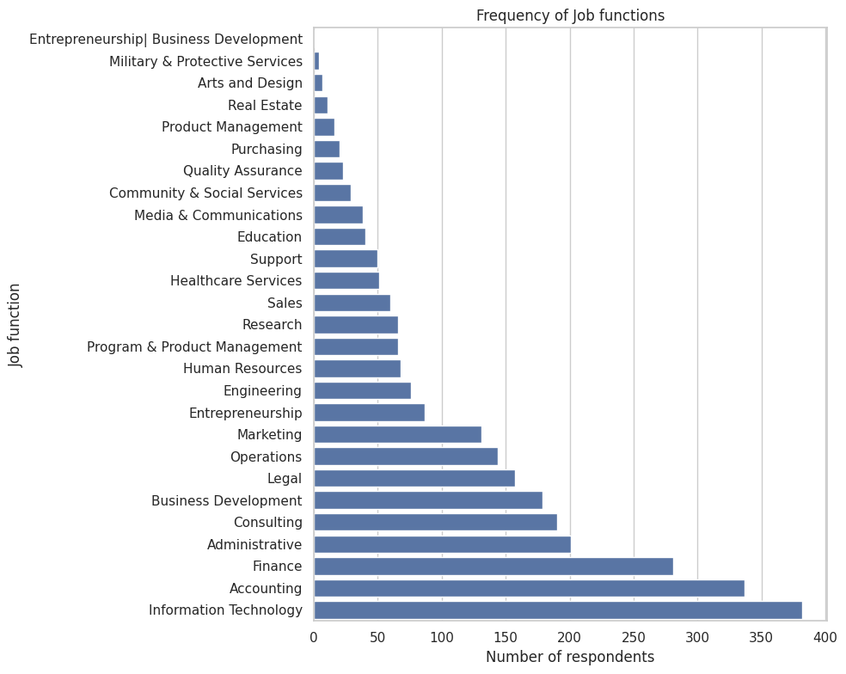
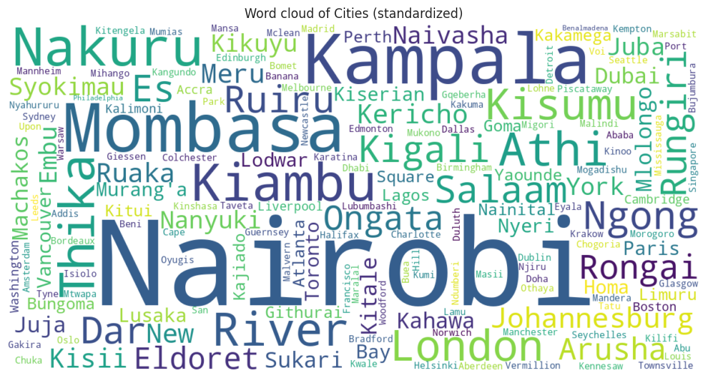
Data Understanding

Slide 6
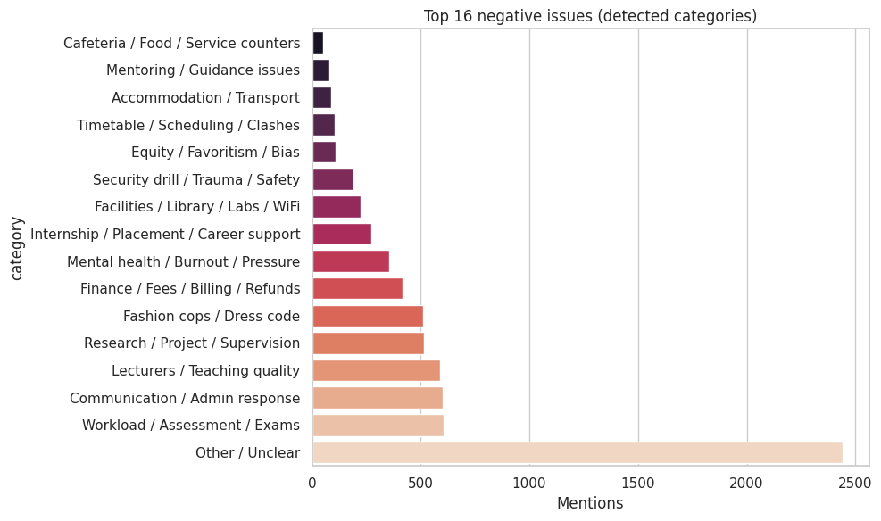
Insight 1: Student Pain Points ⚠️
The most significant challenge is the high pressure of academic rigor alongside persistent issues with administrative efficiency. The administrative friction detracts from the perceived quality of the high-value academic product.
Top 5 Negative Comments
Workload / Assessment / Exams: 605 mentions.
Communication / Admin response: 602 mentions.
Lecturers / Teaching quality: 589 mentions.
Research / Project / Supervision: 514 mentions.
Fashion Cops / Dress code: 510 mentions.

Slide 7
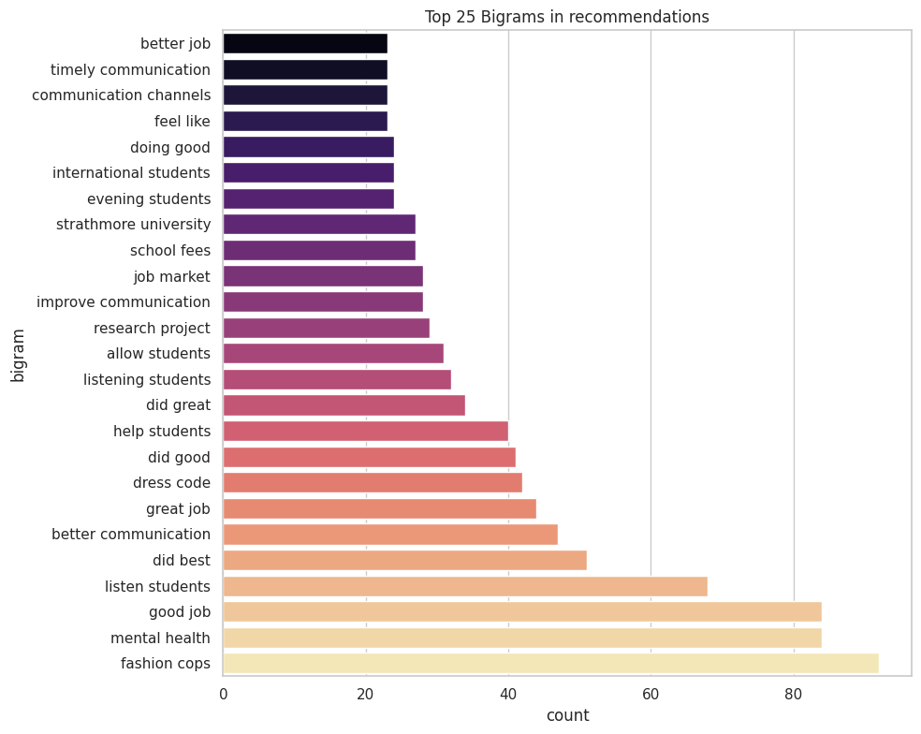
Insight 2: Actionable Demands 💡
Students are clearly demanding enhanced professional preparedness. The requests for Career Services and Practical Skills show a perceived gap between theoretical learning and industry readiness, despite strong job placement.
Top 5 Recommendations
Career Services / Internships: 586 mentions.
Communication / Timely Info: 573 mentions.
More practical / Curriculum / Skills: 337 mentions.
Mentorship / Supervision: 309 mentions.
Fees / Financial Issues: 295 mentions.

Slide 8
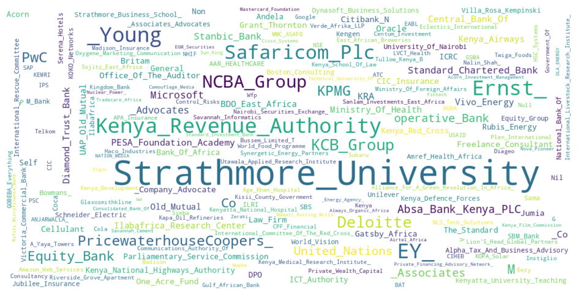

Slide 9
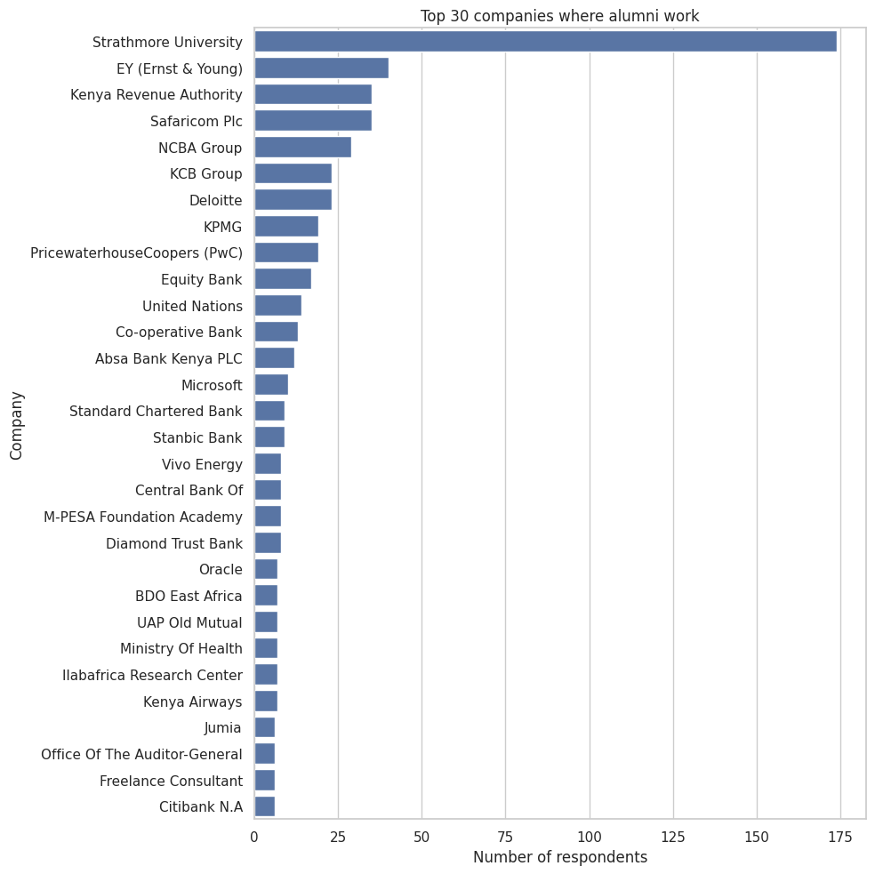
Where our Graduates Land
(by Sector)
Notes:
The job market is heavily dominated by the Finance, Professional Services, and Technology sectors. The internal absorption (Strathmore University) is also a significant outcome.

Slide 10
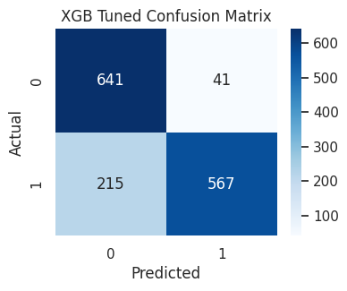
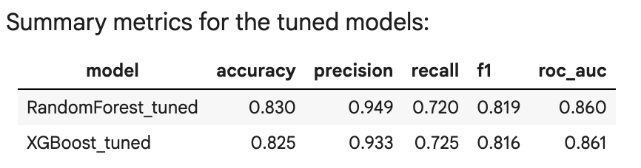
Model Selection
The XGBoost model was selected for its superior mean ROC-AUC score and its low standard deviation, indicating excellent stability and generalization power across various data samples.
Notes:
The model is a robust tool for proactively identifying students who are at risk of a less favorable outcome, allowing for targeted intervention before graduation.

Slide 11
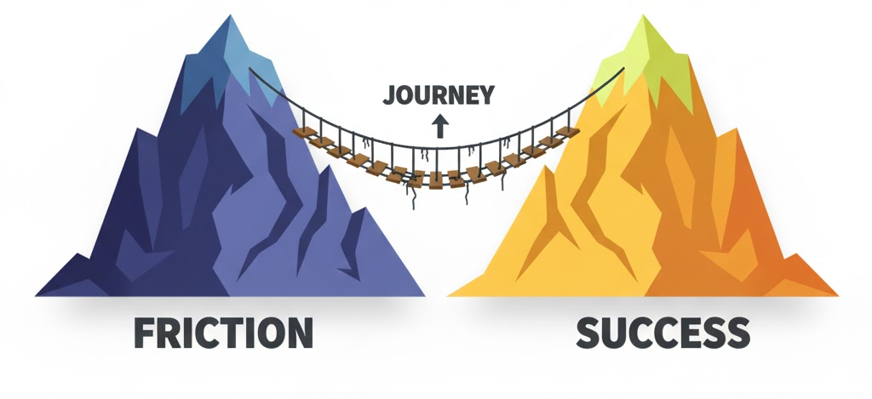
Bridging the Gap
Success vs Strain
The high employment rate confirms academic excellence. However, the qualitative feedback shows that this excellence is achieved despite high student strain from academic load and poor administrative response.
The Career Gap
While graduates secure jobs, their overwhelming demand for Career Services suggests a perceived deficiency in practical skill translation. The university's strong placement record can be made even stronger by formally addressing this student-identified gap.

Slide 12
Key Takeaways
Strathmore successfully aligns graduates with the Finance and Professional Services sector.
The institution must urgently address administrative inefficiencies and high perceived academic pressure.
The XGBoost model provides a high-confidence tool for early identification and targeted support for at-risk students.

Slide 13
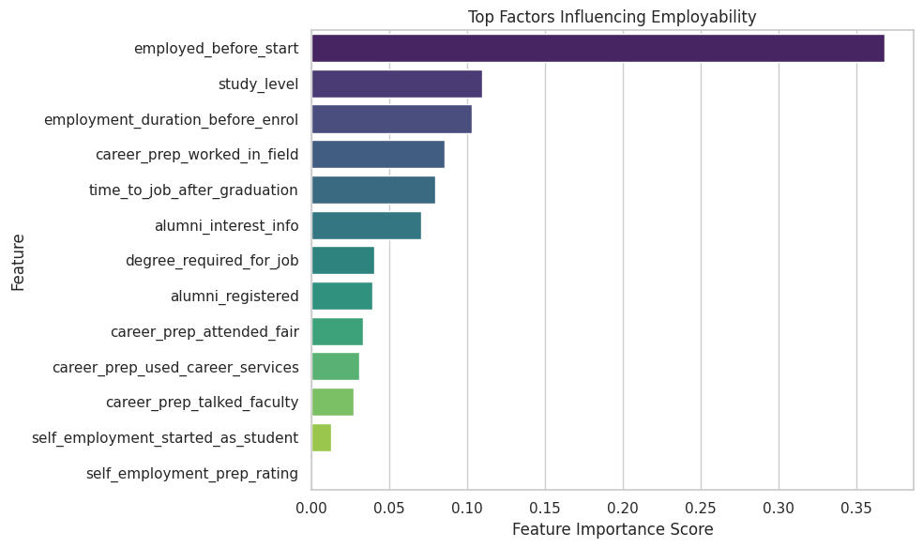
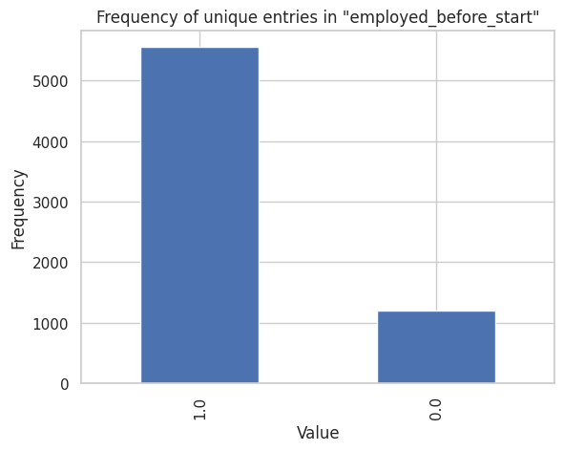
Employment After Strathmore
A reminder of how many students were employed before joining Strathmore
Notes:
The findings reveal that prior work experience and active engagement with career preparation initiatives have the greatest impact on employability. Students who were employed before joining Strathmore or who participated in internships and fieldwork activities demonstrated higher employment outcomes after graduation.
Study level also plays a notable role — graduates with postgraduate qualifications tend to have better employability prospects. Furthermore, alumni engagement variables such as registration and interest in alumni information suggest that continued involvement in the university community enhances professional networking and opportunities.
Strengthen experiential learning programs such as internships, attachments, and work-study initiatives to build students’ practical readiness.
Enhance alumni engagement and mentorship platforms to support career transitions and networking opportunities.
Encourage postgraduate education pathways for specialized skills and improved labor market competitiveness.
Expand career services and job fairs to connect students with potential employers early in their academic journey.

Slide 14
Recommendations
Mandate a career mentorship program (linking alumni to students) to satisfy the #1 recommendation and bridge the practical skills gap.

